Slide 1
Chapter 13: Reference
Why reference
Evaluation
Typing
Store Typings
Safety

Slide 2
References
Notes:
Ocaml is a functional language rather than a procedural programming one;
the key difference between these two classes of languages is the execution model -the way in which programs are executed.
--- Procedural (or imperative) languages, such as C/Java, are based on commands that change the state of machine
on which they execute, e.g., the assignment statement explicitly changes the value stored in some memory location.
---- Functional languages, in contrast, are based on evaluating expressions to produce values.

Slide 3
Computational Effects
Also known as side effects.
A function or expression is said to have a side effect if, in addition to returning a value, it also modifies some state or has an observable interaction with calling functions or the outside world.
modify a global variable or static variable, modify one of its arguments,
raise an exception,
write data to a display or file, read data, or
call other side-effecting functions.
In the presence of side effects, a program's behavior may depend on history; i.e., the order of evaluation matters.

Slide 4
Computational Effects
Side effects are the most common way that a program interacts with the outside world (people, file systems, other computers on networks).
The degree to which side effects are used depends on the programming paradigm.
Imperative programming is known for its frequent utilization of side effects.
In functional programming, side effects are rarely used. Functional languages like Standard ML, Scheme and Scala do not restrict side effects, but it is customary for programmers to avoid them. The functional language Haskell expresses side effects such as I/O and other stateful computations using monadic actions.

Slide 5
Mutability
So far, what we have discussed does not yet include side effects .
In particular, whenever we defined function, we never changed variables or data. Rather, we always computed new data.
E.g., the operations to insert an item into the data structure didn't effect the old copy of the data structure. Instead, we always built a new data structure with the item appropriately inserted.
For the most part, programming in a functional style (i.e., without side effects) is a "good thing" because it's easier to reason locally about the behavior of the program.
Notes:
Good thing?

Slide 6
Mutability
In most programming languages, variables are mutable — i.e., a variable provides both
a name that refers to a previously calculated value, and
the possibility of overwriting this value with another (which will be referred to by the same name)
In some languages (e.g., OCaml), these features are separate:
variables are only for naming — the binding between a variable and its value is immutable
introduce a new class of mutable values (called reference cells or references)
at any given moment, a reference holds a value (and can be dereferenced to obtain this value)
a new value may be assigned to a reference

Slide 7
Mutability
Writing values into memory locations is the fundamental mechanism of imperative languages such as C/C++.
Mutable structures are
required to implement many efficient algorithms.
also very convenient to represent the current state of a state machine.
Notes:
define a type
person
as in the previous chapter. Then, it seems natural to
allow a person to change his/her age, job and the city that person lives in, but
not
his/her name.

Slide 8
Basic Examples
#let r = ref 5
val r : int ref = {contents = 5}
// The value of r is a reference to a cell that always contain a number.
# r:= !r +2
# !r
-: int = 7
(r:=succ(!r); !r)
(r:=succ(!r); r:=succ(!r); r:=succ(!r); r:=succ(!r); !r)

Slide 9
Basic Examples
# let flag = ref true;;
-val flag: bool ref = {contents = true}
# if !flag then 1 else 2;;
-: int = 1

Slide 10
Reference
Basic operations
allocation ref (operator)
dereferencing !
assignment :=
Is there any difference between the expressions of ?
5 + 8;
r: =7;
(r:=succ(!r); !r)
Notes:
? Difference ?

Slide 11
Aliasing
A value of type ref T is a pointer to a cell holding a value of type T.
r =
5
If this value is “copied” by assigning it to another variable： s=r; the cell pointed to is not copied. ( r and s are aliases)
r =
s =
5
So we can change r by assigning to s:
(s:=10; !r)

Slide 12
Aliasing all around us
Reference cells are not the only language feature that introduces the possibility of aliasing
arrays
communication channels
I/O devices (disks, etc.)

Slide 13
The difficulties of aliasing
The possibility of aliasing invalidates all sorts of useful forms of reasoning about programs, both
by programmers...
e.g., function
$λr:Ref Nat. λs:Ref Nat. (r≔2; s≔3; !r)$
always returns $2$ unless $r$ and s are aliases.
... and by compilers:
Code motion out of loops, common sub-expression elimination, allocation of variables to registers, and detection of uninitialized variables all depend upon the compiler knowing which objects a load or a store operation could reference.
High-performance compilers spend significant energy on alias analysis to try to establish when different variables cannot possibly refer to the same storage.

Slide 14
The benefits of aliasing
The problems of aliasing have led some language designers simply to disallow it (e.g., Haskell).
However, there are good reasons why most languages do provide constructs involving aliasing:
efficiency (e.g., arrays)
“action at a distance” (e.g., symbol tables)
shared resources (e.g., locks) in concurrent systems
...…
Notes:
Software bugs due to "action at a distance" may arise because a program component is doing something at the wrong time, or affecting something it should not. “It is very difficult, however, to track down which component is responsible”.
Side effects from innocent actions can put the program in an unknown state, so local data is not necessarily local.
The solution in this particular scenario is to define which components should be interacting with which others.
A proper design that accurately defines the interface between parts of a program, and that avoids shared states, can largely eliminate problems caused by action at a distance.
Proper object oriented programming involves design principles that avoid action at a distance.
The Law of Demeter states that an object should only interact with other objects near itself. Should action in a distant part of the system be required then it should be implemented by propagating a message.
Proper design severely limits occurrences of action at a distance, contributing to maintainable programs.
Pressure to create an object orgy results from poor interface design, perhaps taking the form of a God object, not implementing true objects, or failing to heed the Law of Demeter.
One of the advantages of functional programming is that action at a distance is de-emphasised, sometimes to the point of being impossible to express at all in the source language.
Being aware of the danger of allowing action at a distance into a design, and being able to recognize the presence of action at a distance, is useful in developing programs that are correct, reliable and maintainable.
Given that the majority of the expense of a program may be in the maintenance phase, and that action at a distance makes maintenance difficult, expensive and error prone, it is worth effort during design to avoid.

Slide 15
Example
$$c=ref 0$$
$$incc=λx:Unit. (c≔succ\left(!c\right);!c)$$
$$decc=λx:Unit. (c≔pred\left(!c\right);!c)$$
$$incc unit$$
$$decc unit$$
$$o=\{i=incc, d=decc\}$$
$let newcounter=$o
$${ λ}_{.Unit}.$$
$let c = ref 0 in$
$let incc=λx:Unit. (c≔succ\left(!c\right);!c)$ in
$let decc=λx:Unit. \left(c≔pred\left(!c\right);!c\right)$
$let o=\{i=incc, d=decc\}$ in
$o$

Slide 16
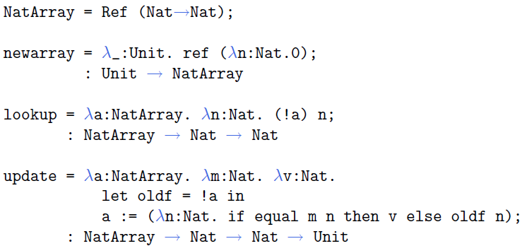
Example

Slide 17
How to enrich the language with the new mechanism ？

Slide 18
Syntax
... plus other familiar types, in examples.

Slide 19
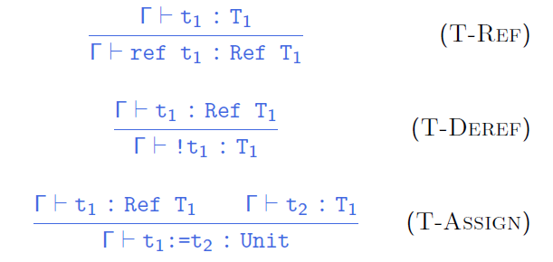
Typing rules
type system
a set of rules that assigns a property called type to
the various “constructs “ of a computer program, such as
variables, expressions, functions or module
Notes:
Strong typed system
type system is a set of rules that assigns a property called type to the various “constructs “ of a computer program, such as variables, expressions, functions or module
A type system associates a type with each computed value and, by examining the flow of these values, attempts to ensure or prove that no type errors can occur.
Type systems are often specified as part of programming languages, and built into the interpreters and compilers for them;
although the type system of a language can be extended by optional tools that perform added kinds of checks using the language's original type syntax and grammar.

Slide 20
Evaluation
What is the value of the expression ref 0 ?
Is
r = ref 0
s = ref 0
and
r = ref 0
s = r
behave the same?
Crucial observation: evaluating ref 0 must do something ?
Specifically, evaluating ref 0 should allocate some storage and yield a reference (or pointer) to that storage.
So what is a reference?

Slide 21
The store
A reference names a location in the store (also known as the heap or just the memory).
What is the store?
Concretely: an array of 8-bit bytes, indexed by 32/64-bit integers.
More abstractly: an array of values.
Even more abstractly: a partial function from locations to values.

Slide 22
Locations
Syntax of values:
... and since all values are terms ...

Slide 23
Syntax of Terms

Slide 24
Aside
Does this mean we are going to allow programmers to write explicit locations in their programs??
No: This is just a modeling trick.
We are enriching the “source language” to include some runtime structures, so that we can continue to formalize evaluation as a relation between source terms.
Aside: If we formalize evaluation in the big-step style, then we can add locations to the set of values (results of evaluation) without adding them to the set of terms.
Notes:
Operational semantics are a category of formal programming language semantics in which certain desired properties of a program, such as correctness, safety or security, are verified by constructing proofs from logical statements about its execution and procedures, rather than by attaching mathematical meanings to its terms (denotational semantics).
Operational semantics are classified in two categories: structural operational semantics (or small-step semantics) formally describe how the individual steps of a computation take place in a computer-based system. By opposition natural semantics (or big-step semantics) describe how the overall results of the executions are obtained.
There are a number of distinctions between small-step and big-step semantics that influence whether one or the other forms a more suitable basis for specifying the semantics of a programming language.
Big-step semantics have the advantage of often being simpler (needing fewer inference rules) and often directly correspond to an efficient implementation of an interpreter for the language (hence Kahn calling them "natural".) Both can lead to simpler proofs, for example when proving the preservation of correctness under some program transformation.
The main disadvantage of big-step semantics is that non-terminating (diverging) computations do not have an inference tree, making it impossible to state and prove properties about such computations.^{[4]}
Small-step semantics give more control of the details and order of evaluation. In the case of instrumented operational semantics, this allows the operational semantics to track and the semanticist to state and prove more accurate theorems about the runtime behaviour of the language. These properties make small-step semantics more convenient when proving type soundness of a type system against an operational semantics.^{[4]}

Slide 25
Evaluation
The result of evaluating a term now (with references)
depends on the store in which it is evaluated.
is not just a value — we must also keep track of the changes that get made to the store.
i.e., the evaluation relation should now map a term as well as a store to a reduced term and a new store.
$t | μ → t^{′} | μ′$
To use the metavariable $μ$ to range over stores.
Notes:
增添reference后，value有被修改的可能，

Slide 26
Evaluation
A term of the form ${ref t}_{1 }$
first evaluates inside $t_{1 }$ until it becomes a value ...
then chooses (allocates) a fresh location $l$, augments the store with a binding from $l$ to $v_{1 }$, and returns $l$ :
Notes:
L is said to be fresh for \miu

Slide 27
Evaluation
A term !t₁ first evaluates in t₁ until it becomes a value...
... and then
looks up this value (which must be a location, if the original term was well typed) and
returns its contents in the current store

Slide 28
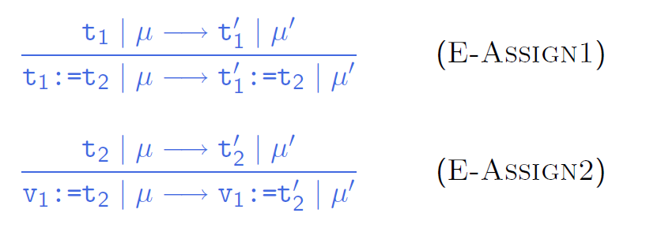
Evaluation
An assignment $t_{1 }≔ t_{2}$ first evaluates $t_{1 }$ and $t_{2}$until they become values ...
... and then returns unit and updates the store:

Slide 29
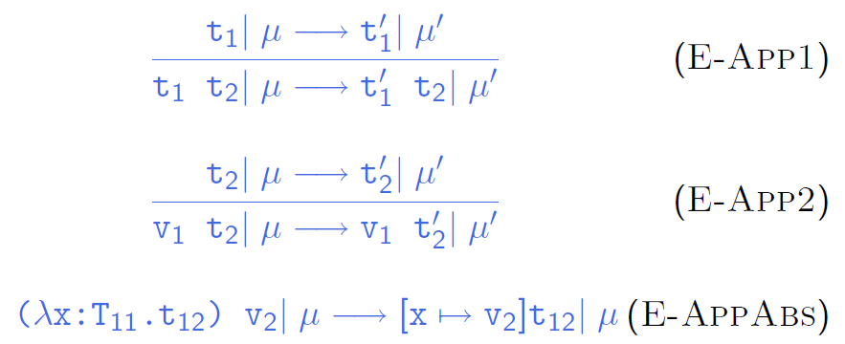
Evaluation
Evaluation rules for function abstraction and application are augmented with stores, but don’t do anything with them directly.

Slide 30
Aside
Garbage Collection
Note that we are not modeling garbage collection — the store just grows without bound.
It may not be problematic for most theoretical purposes, whereas it is clear that for practical purposes some form of deallocation of unused storage must be provided.
Pointer Arithmetic
p++;
We can’t do any!

