Slide 1
Store Typing
Notes:
之前 store

Slide 2
Typing Locations
Question: What is the type of a location?
Answer: Depends on the contents of the store!
For example,
in the store $(l_{1}$ $⟼$unit, $l_{2}$ $⟼$unit$)$ , the term ${!l}_{2}$ is evaluated to unit, having type $Unit$.
But in the store $(l_{1}$ $⟼$unit, $l_{2}$ $⟼λx:Unit.x)$, the term ${!l}_{2}$ has type $Unit→Unit$ .

Slide 3
Typing Locations — first try
Roughly, to find the type of a location $l$, first look up the current contents of $l$ in the store, and calculate the type $T_{1}$ of the contents:
More precisely, to make the type of a term depend on the store (keeping a consistent state), we should change the typing relation from three-place to :
i.e., typing is now a four-place relation (about contexts, stores, terms, and types), though the store is a part of the context ……
Notes:
根据l 中存储内容来确定其类型
term的类型，除了context之外，还依赖于存储store

Slide 4
Problems #1
However, this rule is not completely satisfactory, and is rather inefficient.
First of all, it can make typing derivations very large (if a location appears many times in a term) !
e.g., if
$μ=(l_{1 }↦λx:Nat. 999$,
$l_{2 }↦λx:Nat. (!l_{1 }$) x,
$l_{3 }↦λx:Nat. (!l_{2 }$) x,
$l_{4 }↦λx:Nat. (!l_{3}$) x,
$l_{5 }↦λx:Nat. (!l_{4}$) x),
then how big is the typing derivation for ${!l}_{5}$?

Slide 5
Problems #2
But wait... it gets worse if the store contains a cycle. Suppose
$$μ=(l_{1 }↦λx:Nat. (!l_{2 }\text{) }\text{x}\text{,}$$
$l_{2 } ↦λx:Nat.$ $(!l_{1 }$) x)) ,
how big is the typing derivation for ${!l}_{2}$?
Calculating a type for $l_{2}$ requires finding the type of $l_{1}$, which in turn involves $l_{2}$.
Notes:
为什么？

Slide 6
Why?
What leads to the problems?
Our typing rule for locations requires us to recalculate the type of a location every time it’s mentioned in a term, which should not be necessary.
In fact, once a location is first created, the type of the initial value is known, and the type will be kept even if the values can be changed.

Slide 7
Store Typing
Observation:
The typing rules we have chosen for references guarantee that a given location in the store is always used to hold values of the same type.
These intended types can be collected into a store typing:
— a partial function from locations to types.

Slide 8
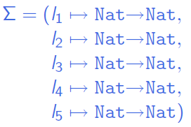
Store Typing
E.g., for
A reasonable store typing would be
$μ=(l_{1 }↦λx:Nat. 999$,
$l_{2 }↦λx:Nat. (!l_{1 }$) x,
$l_{3 }↦λx:Nat. (!l_{2 }$) x,
$l_{4 }↦λx:Nat. (!l_{3}$) x,
$l_{5 }↦λx:Nat. (!l_{4}$) x ) ,

Slide 9
Store Typing
Now, suppose we are given a store typing $Σ$describing the store $μ$ in which we intend to evaluate some term t. Then we can use $Σ$ to look up the types of locations in t instead of calculating them from the values in $μ$.
i.e., typing is now a four-place relation on contexts, store typings, terms, and types.
Proviso: the typing rules accurately predict the results of evaluation only if the concrete store used during evaluation actually conforms to the store typing.
Notes:
plural provisos: 限制性条款
with the proviso that ...
附加条件是…

Slide 10
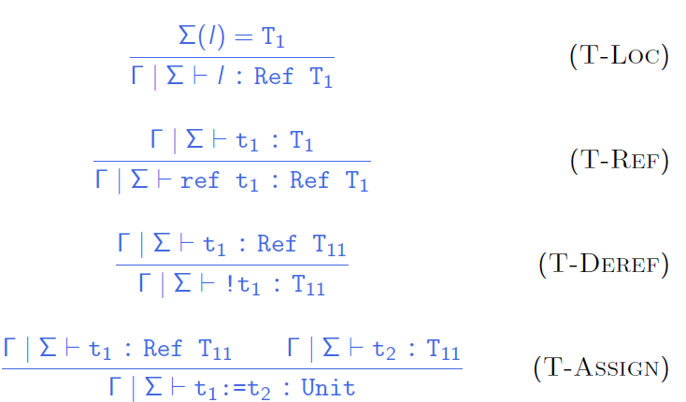
Final typing rules

Slide 11
Store Typing
Question: Where do these store typings come from?
Answer: When we first typecheck a program, there will be no explicit locations, so we can use an empty store typing, since the locations arise only in terms that are the intermediate results of evaluation.
So, when a new location is created during evaluation,
we can observe the type of $v_{1}$ and extend the “current store typing” appropriately.
Notes:
\sigma (store typing) 如何构建？

Slide 12
Store Typing
As evaluation proceeds and new locations are created, the store typing is extended by looking at the type of the initial values being placed in newly allocated cells.
∑ only records the association
between
already-allocated storage cells and
their types.

Slide 13
Safety
Coherence between the statics and the dynamics
Well-formed programs are well-behaved
Notes:
Type safety expresses the coherence between the statics and the dynamics.
Most programming languages exhibit a phase distinction between the static and dynamic phases of processing:
The static phase consists of parsing and type checking to ensure that the program is well-formed; the dynamic phase consists of execution of well-formed programs.
A language is said to be safe exactly when well-formed programs are well-behaved when executed.
The static phase is specified by a statics comprising a collection of rules for deriving typing judgments stating that an expression is well-formed of a certain type.
Types mediate the interaction between the constituent parts of a program by “predicting” some aspects of the execution behaviors of the parts so that we may ensure they fit together properly at runtime.
Type safety tells us that these predictions are accurate; if not, the statics is considered to be improperly defined, and the language is deemed unsafe for execution.

Slide 14
Preservation
the steps of evaluation
preserve
typing

Slide 15
Preservation
How to express the statement of preservation?
First attempt: just add stores and store typings in the appropriate places.
Theorem(?): if $Γ | Σ ⊢t:T$ and $t\left|μ ⟶t^{′}\right|μ^{′}$, then $Γ | Σ ⊢t′:T$
Right??
Wrong!
Why wrong?
Because $Σ$ and $μ$ here are not constrained to have anything to do with each other!
Exercise: Construct an example that breaks this statement of preservation
Notes:
(Exercise on class : Construct an example that breaks this statement of
preservation.)！！！

Slide 16
Preservation
Definition: A store $μ$ is said to be well typed with respect to a typing context $Γ$and a store typing $Σ$, written $Γ | Σ⊢μ$, if $dom\left(μ\right)=dom\left(Σ\right)$and $Γ | Σ⊢μ\left(l\right): Σ\left(l\right)$ for every $l∈dom\left(μ\right)$.
Theorem (?) : if
$Γ | Σ⊢t:T$
$t \left| μ⟶t^{′}\right| μ′$
$Γ | Σ⊢μ$
then $Γ | Σ⊢t′:T$
Right this time?
Still wrong !
Why? Where? (E-REFV）
Notes:
直觉上，If every value om the store has the type predicated by the store typing, then a store \mu is consistent with a store typing \Sigma
How about allocation rule?

Slide 17
Preservation
Creation of a new reference cell ...
$\frac{l ∉ dom\left(μ\right)}{ref v_{1}\left| μ ⟶ l \right|(μ, l ↦v_{1})}$ (E-REFV)
... breaks the correspondence between the store typing and the store.
Since the store can grow during evaluation:
Creation of a new reference cell yields a store with a larger domain than the initial one, making the conclusion incorrect: if $μ′$includes a binding for a fresh location $l$, then $l$ cann’t be in the domain of $Σ$, and it will not be the case that $t′$ is typable under $Σ$.

Slide 18
Preservation
Theorem: if
$Γ | Σ⊢t:T$
$Γ | Σ⊢μ$
$t | μ ⟶t^{′}| μ′$
then, for some $Σ^{′}⊇ Σ$,
$Γ | Σ′⊢t′:T$
$Γ | Σ′⊢μ′$.
A correct version.
What is $Σ^{′}$ ?
Proof: Easy extension of the preservation proof for $λ_{→}$.
Notes:
\Sigma’ is either \Sigma or (\mu, l \derive T)

Slide 19
Progress
well-typed expressions are
either values
or can be further evaluated
Notes:
The dynamics of a language is a description of how programs are to be executed.
The most important way to define the dynamics of a language is by the method of structural dynamics,
which defines a transition system that inductively specifies the step-by-step process of executing a program.

Slide 20
Progress
Theorem:
Suppose $t$ is a closed, well-typed term
(i.e., $Γ| Σ⊢t:T$ for some $T$ and $Σ)$
then either$t$ is a value or else, for any store $μ$ such that $Γ| Σ⊢μ$, there is some term $t′$and store $μ′$ with
$$t | μ ⟶t′ | μ′$$

Slide 21
Safety
preservation and progress together constitute the proof of safety
progress theorem ensures that well-typed expressions don’t get stuck in an ill-defined state, and
preservation theorem ensures that if a step is a taken the result remains well-typed (with the same type).
These two parts ensure the statics and dynamics are coherent, and that no ill-defined states can ever be encountered while evaluating a well-typed expression

Slide 22
In summary …

Slide 23
Syntax
We added to $λ_{→}$ (with $Unit$) syntactic forms for creating, dereferencing, and assigning reference cells, plus a new type constructor $Ref$.

Slide 24
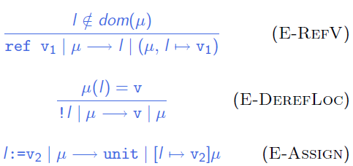
Evaluation
Evaluation relation: $t | μ ⟶ t′ | μ′$

Slide 25
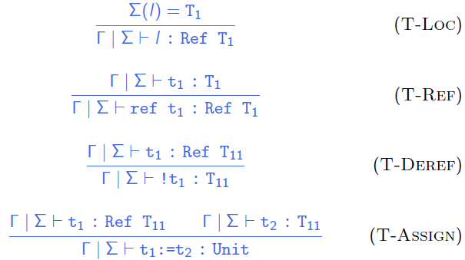
Typing
Typing becomes a four-place relation: $Γ | Σ⊢ t : T$

Slide 26
Preservation
Theorem: if
$Γ | Σ⊢t:T$
$Γ | Σ⊢μ$
$t | μ ⟶t^{′}| μ′$
then, for some $Σ^{′}⊇Σ$,
$Γ | Σ′⊢t′:T$
$Γ | Σ′⊢μ′$.
Notes:
The preservation theorem merely asserts that there is some store typing \Sigma’ contains \Sigma, such that the new term t’ is well typed w.r.t. \Sigma’, it does not tell us what \Sigma’is. It’s clear that \Sigma’ is either \Sigma or else it is exactly (\mu, l-> T1), where l is the newly allocated location.

Slide 27
Progress
Theorem: Suppose $t$ is a closed, well-typed term (that is,
$∅ | Σ⊢t:T$ for some $T$ and $Σ)$. Then either $t$ is a value or else, for any store $μ$ such that$∅ | Σ⊢μ$, there is some term $t′$and store $μ′$ with $t | μ ⟶t′ | μ′.$
Notes:
The combination of preservation and progress together constitute the proof of safety: the progress theorem ensures that well-typed expressions don’t get stuck in an ill-defined state, and preservation theorem ensures that if a step is a taken the result remains well-typed (with the same type).
These two parts work hand-in-hand to ensure the statics and dynamics are coherent, and that no ill-defined states can ever be encountered while evaluating a well-typed expression.

Slide 28
Others …

Slide 29
Arrays
Fix-sized vectors of values. All of the values must have the same type, and the fields in the array can be accessed and modified.
e.g., arrays can be created with in Ocaml
[|e₁; … ; e_{n}|]
# let a = [|1;3;5;7;9|];;
val a : int array = [|1;3;5;7;9|]
#a;;
-: int array = [|1;3;5;7;9|]

Slide 30
Recursion via references
Indeed, we can define arbitrary recursive functions using references
Allocate a $ref$ cell and initialize it with a dummy function of the appropriate type:
$${fact}_{ref} = ref (λn:Nat.0)$$
Define the body of the function we are interested in, using the contents of the reference cell for making recursive calls:
${fact}_{body}=$
$λn:Nat.$
$if iszero n then 1 else times n ((!{fact}_{ref})(pred n))$
“Backpatch” by storing the real body into the reference cell:
${fact}_{ref} :={fact}_{body}$
Extract the contents of the reference cell and use it as desired:
$fact = !{fact}_{ref}$
$fact 5$

Slide 31
Homework☺
Read chapter 13
Read and chew over the codes of fullref.
HW: 13.3.1 and 13.5.2
Preview chapter 14

Slide 32
Nontermination via references
There are well-typed terms in this system that are not strongly normalizing. For example:
$t1=λr:Ref \left(Unit→Unit\right).$
$(r ≔\left(λx:Unit. \left(!r\right)x\right);$
$\left(!r\right) unit);$
$t2=ref \left(λx:Unit. x\right);$
Applying $t1$ to $t2$ yields a (well-typed) divergent term.

