Slide 1
Beanbag: A Language for Automatic Model Inconsistency Fixing
(published at ESEC/FSE’09)
Yingfei Xiong
Ph.D., University of Tokyo
Will be a postdoc@Univ. Waterloo since Dec
Joint work with
Zhenjiang Hu, Haiyan Zhao, Hui Song,
Masato Takeichi, and Hong Mei
Notes:
change the author order

Slide 2
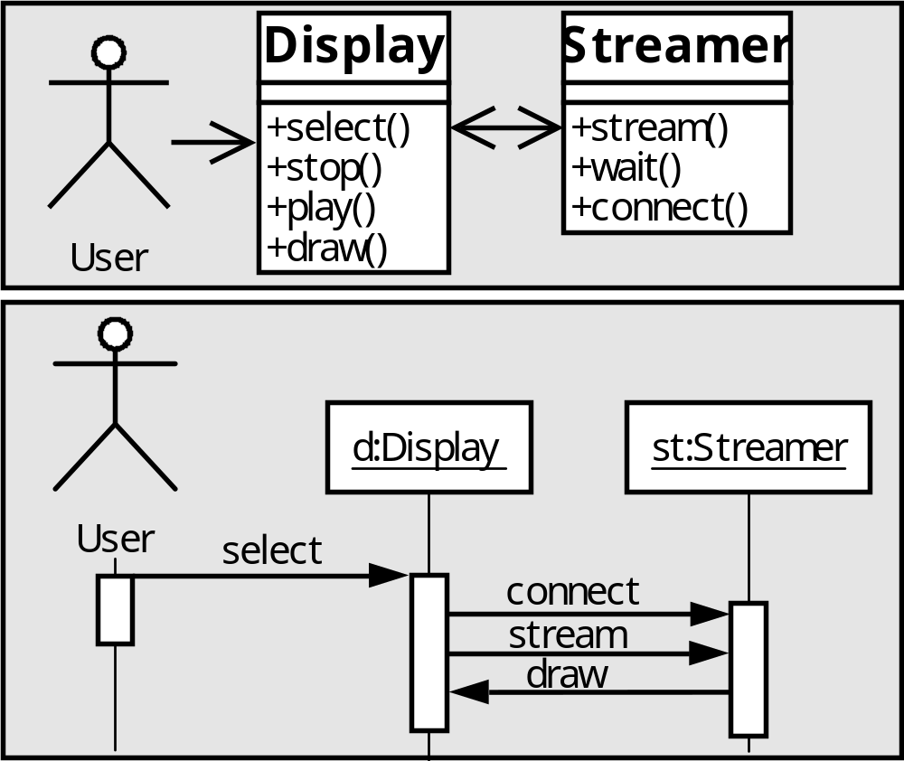
Motivation
Model software system often involves models with complex relations.
Equal

Slide 3
Relation Description in OCL
Equal
C1: context Message
inv let rec = self.receiver in
let ops = rec.base.operations in
ops->exists(oper | oper.name = self.name)

Slide 4
Inconsistency
Inconsistency will be caused when some part is updated by users
Not equal!
choose
Notes:
from down to up

Slide 5
Inconsistency Fixing
We need to propagate the updates to other part of the model to fix the inconsistency.
choose
choose

Slide 6
Existing Approaches
Manual Fixing Procedures
  By common programming languages [Grundy94]
  By logic expressions [Finkelstein94, Straeten03]
  Fully automated fixing, but requires considerable development cost
Generating Fixing Actions from Consistency Relations
  White box analysis [Egyed08]
  Black box analysis [Nentwich03]
  Fully automated development, but requires user intervention in fixing

Slide 7
Can we automatically derive fixing procedures from consistency relations?
Notes:
add related work

Slide 8
Fixing Behavior Ambiguity
C1: context Message
inv let rec = self.receiver in
let ops = rec.base.operations in
ops->exists(oper | oper.name = self.name)
A consistency relation may correspond to multiple fixing behaviors
Need developers to tell the system which one to use
choose()
choose
choose

Slide 9
Our Solution : Beanbag
Beanbag
  A language for specifying fixing behavior from consistency relation perspective
  similar to OCL syntactically
  having enriched constructs to describe a unique fixing behavior
Every Beanbag Program has two types of semantics
  Checking semantics for checking whether the relation is satisfied
  Fixing semantics for fixing inconsistency by update propagation

Slide 10

Working Process of Beanbag
Updates
Fixing Procedure
Compile
------------
------------
------------
------------
Application Data
Beanbag Program
Updates

Slide 11
Example 1 : A Simple Program
2
2
2
a=1
b=1
c=1
def main(a, b, c) := a = b and b = c
  input values: {a=1, b=1, c=1}
  input updates: {a->2}
  output updates: {a->2, b->2, c->2}

Slide 12
Example 2: Customizing Fixing Behavior
obj1
obj2
name=Book
persistent=true
name=Book
persistent=false
name=Book
def main(obj1, obj2) :=
obj1."persistent" = true
and obj2."name" = obj1."name"
or obj1."persistent" = false and obj2 = null
or obj1 = null and obj2 = null
  input values: {obj1={name=Book, persistent=true}, obj2={name=Book}}
  input updates: {obj2->null}
  output updates: {obj1->{persistent->false}, obj2->null}

Slide 13
Example 2: Customizing Fixing Behavior
obj1
obj2
name=Book
persistent=true
name=Book
def main(obj1, obj2) :=
obj1."persistent" = true
and obj2."name" = obj1."name"
or obj1 = null and obj2 = null
or obj1."persistent" = false and obj2 = null
  input values: {obj1={name=Book, persistent=true}, obj2={name=Book}}
  input updates: {obj2->null}
  output updates: {obj1->null, obj2->null}

Slide 14
Example 3: the Running Example
context Message
inv let rec = self.receiver in
let ops = rec.base.operations in
ops->exists(oper | oper.name = self.name)
OCL
def C1(msg, model) =
let rec = model.(msg."receiver") in
let opRefs = model.(rec."base")."operations" in
opRefs->exists(opRef | model.opRef."name"=msg."name")
Beanbag

Slide 15
Overview: Constructs in Beanbag
expr ::= variable
| constant
| expr.expr
| not expr
| expr=expr
| expr and expr
| expr or expr
| expr->forall(v|expr)
| expr->exists(v|expr)
| expr->exists!(v|expr)

Slide 16
Overview: Enriched Constructs for Specifying Synchronization Behavior
OCL Constructs | Enriched Constructs
expr1=expr2 | expr1=expr2 expr2=expr1
expr1 and expr2 | expr1 and expr2 expr2 and expr1
expr1 or expr2 | expr1 or expr2 expr2 or expr1
expr->exists(v | expr) | expr->exists(v | expr) expr->exists!(v | expr)

Slide 17
The Fixing Semantics
Basic relations (like a=b) | Primitive fixing procedures
Connectives (like and, or, forall) | gluing their small fixing procedures into a bigger one
Consider an example:
  Relation: a=b and b=c
and
a=b
b=c

Slide 18
Primitive Fixing Procedures: a=b
a=b
3
3
3
3
a=2
a=2
a=2
a=2
3
3
3
4
b=2
b=2
b=2
b=2
report conflict

Slide 19
Combinator
and
a=b
b=c
a=3
b=3
c=3
1
1
1

Slide 20
Correctness Properties
The fixing semantics of Beanbag is well-defined in the sense that it satisfies the following three properties
  Consistency
  Preservation
  Stability

Slide 21
Consistency
After fixing, the data always satisfy the consistency relation
choose
Equal
choose

Slide 22
Preservation
A fixing procedure does not overwrite user updates
select
choose

Slide 23
Stability
If there is no update, the fixing procedure produces no update.

Slide 24
Evaluating the Expressiveness
Steps
  Collected 84 consistency relations from MOF standard, UML standard, and industry [Egyed07]
  Identified requirements for 24 fixing procedures
  Implementing these programs in Beanbag
Result
  Implemented 17 programs, 71% of all programs
  The rest 7 programs can be implemented with small extensions to Beanbag
Notes:
add slides for evaluation

Slide 25
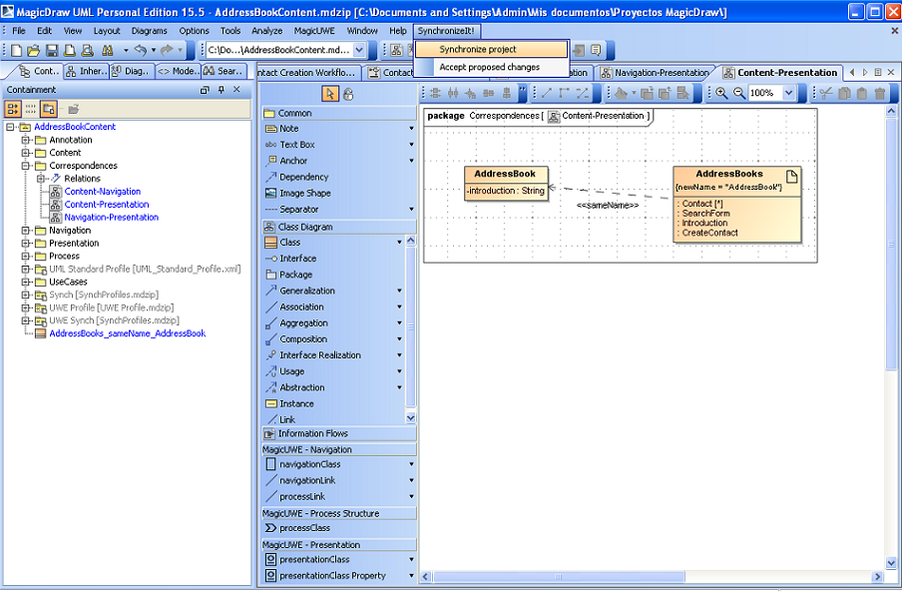
Implementation
Beanbag has been implemented and published on the web
Beanbag URL:
  http://www.ipl.t.u-tokyo.ac.jp/~xiong/beanbag.html
An old version has been used by several other research groups [RKK+09]
A graphic UML synchronization tool
that is developed by University of
Malaga using Beanbag

Slide 26
What is new comparing to the previous version?
26
OCL-based language
No dependence on the state of synchronizers
  no different sync and resync
Clearly defined checking semantics from OCL
Notes:
26

Slide 27
Conclusion
Inconsistency fixing can be approached by a language
  attaching fixing actions to primitive relations
  gluing primitive relations by combinators
The fixing behavior of the language is predictable as it satisfies the three properties
The language is expressive as it can express many useful fixing behaviors in practice
Notes:
be quick

Slide 28
Thank you for your attention!
Beanbag URL:
  http://www.ipl.t.u-tokyo.ac.jp/~xiong/beanbag.html

Slide 29
What Relations are Suitable for Automatic Inconsistency Fixing
Fixing actions need to be taken
  obj.”name”=“SpecialName”
Fixing is sensible without human intervention
  No Circle Inheritance

Slide 30
What Small Extensions are Needed
One program requires a new constraint without fixing action
  A function count the number of entries in dictionary
Other six programs require the ability to access key in forall
All extensions conform to the basic idea of Beanbag
  attaching fixing actions to primitive expressions, and composing them using high-level constructs.

Slide 31
Fixing Procedures
Current approaches [Grundy94] provide automatic fixing through fixing procedures
Fixing procedure:
  When a type of change occurs
  Do actions
An example
  When a method in a class diagram is renamed
  Do
  find corresponding messages in sequence diagrams
  rename these messages

Slide 32
Fixing Behavior Customization
def C1(msg, model) =
let rec = model.(msg."receiver") in
let opRefs = model.(rec."base")."operations" in
opRefs->exists(opRef | model.opRef."name"=msg."name")
choose()
choose

Slide 33
Fixing Behavior Customization
def C1(msg, model) =
let rec = model.(msg."receiver") in
let opRefs = model.(rec."base")."operations" in
opRefs->exists!(opRef | model.opRef."name"=msg."name")
choose
choose

