Slide 1
Beanbag: Facilitating Model Inconsistency Fixing
Yingfei Xiong
Ph.D. Student
Advisor: Zhenjiang Hu and Masato Takeichi
University of Tokyo
Notes:
Problems of these slides:
Too many details. People have to concentrate to follow
For people outside the SE, they do not know what OCL is

Slide 2
Contents(45mins)
Introduction
  Running example C1 (try to find a better one)
  Beanbag
The Beanbag Language
  primitives
    values and updates
    equality, constant equality, and, or
  Structural Values
    dictionaries
    dictionary updates
    forall
      control deletion
    exists
      control insertion
  Representing Objects
    How to represent objects using dictionaries
    get attribute: d.k, let
    referencing attribute in another object: one
Experiment and Implementation
Conclusion
Notes:
todo: find key binding for “forall” and “exists”
todo: find definition for “one”

Slide 3
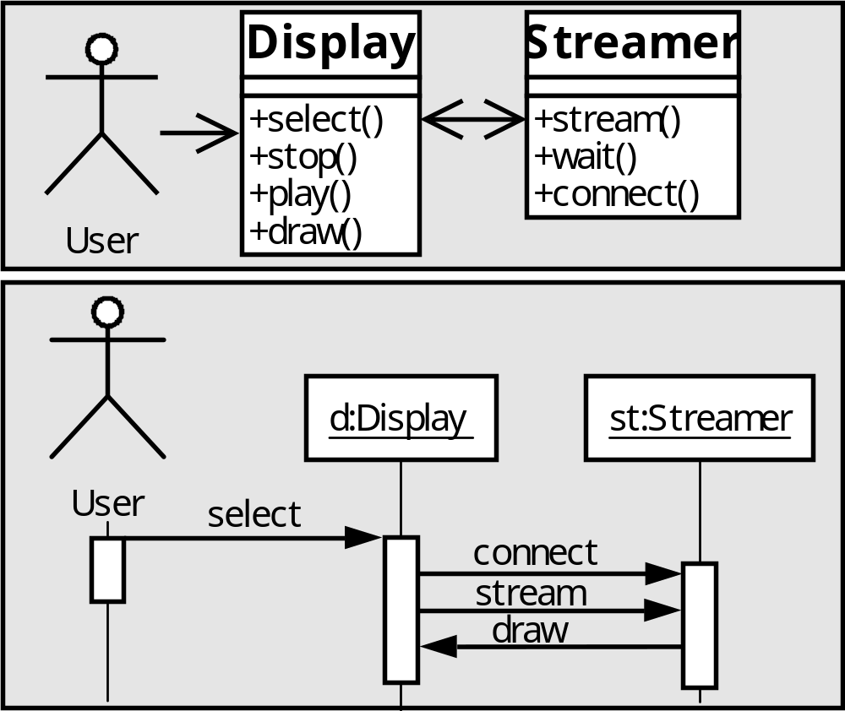
Motivation
Model software system often involves models with complex relations.
Equal
Dependent

Slide 4
Relation Description in OCL
C1: context Message
inv let rec = self.receiver in
let ops = rec.base.operations in
ops->exists(oper | oper.name = self.name)
C2: context Message
inv self.sender <> null and self.receiver <> null

Slide 5
Inconsistency
Inconsistency will be caused when some part is updated by users
choose

Slide 6
Automatic Inconsistency Fixing
Modern modeling tools propagate updates automatically to fix inconsistency
choose
choose

Slide 7
Fixing Procedures
Current approaches [Grundy94] provide automatic fixing through fixing procedures
Fixing procedure:
  When a type of change occurs
  Do actions
An example
  When a method in a class diagram is renamed
  Do
  find corresponding messages in sequence diagrams
  rename these messages

Slide 8
Problem 1 : High Development Cost
C1: context Message
inv let rec = self.receiver in
let ops = rec.base.operations in
ops->exists(oper | oper.name = self.name)
Many types of updates may violate a relation
Developers have to write code for each type
Rename
Delete
Change Type
Rename
Move

Slide 9
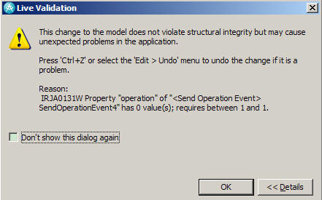
Problem 1 : High Development Cost
C1: context Message
inv let rec = self.receiver in
let ops = rec.base.operations in
ops->exists(oper | oper.name = self.name)
IBM Rational Software Architect has failed to implement fixing actions for some types of changes
Rename
Delete
Change Type
Rename
Move

Slide 10
Problem 2 : Correctness not Assured
It is difficult to verify whether the fixing actions correctly propagate the updates or not
  When a method in a class diagram is renamed
  Do
  find all messages in sequence diagrams
  rename these messages

Slide 11
Idea : Automatic Derivation of Fixing Procedures
From simple relations like a=b, fixing procedures can be automatically derived
3
3
3
3
a=2
a=2
a=2
a=2
3
3
3
4
b=2
b=2
b=2
b=2
report conflict
Idea : derive fixing procedures from consistency relations

Slide 12
Problem
C1: context Message
inv let rec = self.receiver in
let ops = rec.base.operations in
ops->exists(oper | oper.name = self.name)
A consistency relation may correspond to multiple fixing procedures
Need developers to tell the system which one to use
choose()
choose
choose

Slide 13
Our Solution : Beanbag
A language for writing fixing procedures from consistency relation perspective
Attaching fixing semantics to common OCL constructs
Providing multiple ways to construct one relation, each representing a different fixing behavior

Slide 14
Beanbag Program: An Example
context Message
inv let rec = self.receiver in
let ops = rec.base.operations in
ops->exists(oper | oper.name = self.name)
OCL
def C1(msg, model) =
let rec = model.(msg."receiver") in
let opRefs = model.(rec."base")."operations" in
opRefs->exists(opRef | model.opRef."name"=msg."name")
Beanbag

Slide 15
Working Process of Beanbag
Users
Updates
Fixing Procedure
Compile
------------
------------
------------
------------
Application Data
Beanbag Program
Updates

Slide 16
Customize Fixing Behavior
def C1(msg, model) =
let rec = model.(msg."receiver") in
let opRefs = model.(rec."base")."operations" in
opRefs->exists(opRef | model.opRef."name"=msg."name")
rename a message
add a new operation
def C1(msg, model) =
let rec = model.(msg."receiver") in
let opRefs = model.(rec."base")."operations" in
opRefs->exists!(opRef | model.opRef."name"=msg."name")
rename a message
rename an operation

Slide 17
Correctness Properties
What fixing procedures are correct?
  Consistency
  Preservation
  Stability

Slide 18
Consistency
After updating, the data should satisfy the consistency relation
choose
Equal
choose

Slide 19
Preservation
A fixing procedure cannot overwrite user updates
choose
select

Slide 20
Stability
If there is no update, the synchronizer produce no update.

Slide 21
Beanbag Language
First, let us consider relations on primitive values
Primitive values: integers, strings, booleans…
Updates on primitive values:
  !v: replace the old value with v
  void: no update
Basic Relation: a = b
a:2
b:2
a:!1
b:void
a=b
a:!1
b:!1

Slide 22
a=v
a=2
a:2
a:!2
a:!2
a=2
a:2
a:!1
failure!

Slide 23
Conjunction
a:2
b:2
c:2
a:void
b:void
c:!1
a:!1
b:!1
c:!1
a=b and
b=c
a:2
b:2
a:void
b:void
a=b
a:void
b:void
b:2
c:2
b:void
c:!1
b=c
b:!1
c:!1
a:2
b:2
a:void
b:!1
a=b
a:!1
b:!1

Slide 24
Disjunction
a=1 or a=2
Basic idea: use either “a=1” or “a=2” to synchronize
Problem: When we change a from 1 to 2, the input value a=1 is not consistent for “a=2”
Solution: Require fixing procedures to handle inconsistent input values

Slide 25
Handling Inconsistent Values
a:2
b:3
a:!1
b:void
a=b
a:!1
b:!1
a:2
b:3
a:void
b:void
a=b
a:!3
b:!3
a=2
a:3
a:void
a:!2

Slide 26
Disjunction
a=1 or
a=2
a:!2
a:1
a:!2
a=1
a:1
a:!2
failure!
a=2
a:1
a:!2
a:!2

Slide 27
Customize Fixing Behavior in Disjunction
a:5
b:5
c:5
a:!3
b:void
c:void
a:!3
b:!3
c:void
a=b or
a=c
a:5
b:5
c:5
a:!3
b:void
c:void
a:!3
b:void
c:!3
a=c or
a=b

Slide 28
Customize Fixing Behavior in Disjunction
a:5
a:void
a=1 or
a=2
a:!1
a:5
a:void
a=2 or
a=1
a:!2

Slide 29
Protecting variables from being changed by fixing procedures
a:2
b:3
a:void
b:!1
protect a in
a=b
failure!
a:2
b:3
a:!1
b:void
protect a in
a=b
a:!1
b:!1

Slide 30
Dictionaries: Structural Values
A dictionary maps keys to values
  {1->”a”, 2->”b”, 3->”c”}
  {“Name”->”UserEJB”, “Persistent”->true}
An update on dictionary is also a dictionary mapping from keys to updates
  ,4->”y”
  “x”
  {1->”a”, 2->”b”, 3->”c”}
{1->!”x”, 2->!null, 4->!”y”}

Slide 31
Representing Objects
{1->{name ->Display,
operations->{10->2, 11->3, 12->4, 13->5}} ,
2->{name->select,
parameters->{}} ,
3->{name->stop,
parameters->{}} ,
4->{name->play,
parameters->{}} ,
5->{name->draw,
parameters->{}} ,

Slide 32
d.k: getting value from dictionary
d:{a->1, b->3}
k:a
v:1
d:void
k:void
v:!2
d:{a->!2}
k:void
v:!2
v=d.k
d:{a->1, b->3}
k:a
v:1
d:void
k:!b
v:void
d:void
k:void
v:!3
v=d.k
d:{a->1, b->3}
k:a
v:4
d:void
k:void
v:void
d:void
k:void
v:!1
v=d.k
What if we want to write (d.k1).k2 or d1.(d2.k)?

Slide 33
let
let k’=d2.k in v=d1.k’
  v=d1.(d2.k)
let d’=d.k1 in v=d’.k2
  v=d.k1.k2
The fixing semantics of “Let” is similar to “and”
  let k’=d2.k in v=d1.k’
  k’=d2.k and v=d1.k’
but we must find the value of k’

Slide 34
E : evaluate expressions like OCL
E[d.k] = d.k
E[v1=v2] = v1==v2
E[expr1 and expr2] = E[expr1] ⋀ E[expr2]
E[expr1 or expr2] = E[expr1] ⋁ E[expr2]
Let: First evaluate the value of the inner variable, then proceed as “and”

Slide 35
The fixing procedure of Let
d1:{a->i, b->j}
d2:{1->a, 2->b}
k:1
v:i
d1:void
d2:void
k:!2
v:void
d1:void
d2:void
k:!2
v:!j
let k’=d2.k
in v=d1.k’
k’:E[d2.k]=a
d2:{1->a, 2->b}
k:1
k’:void
d2:void
k:!2
k’=d2.k
k’:!b
d2:void
k:!2
k’:E[d2.k]=a
d1:{a->i, b->j}
v:i
k’:!2
d1:void
v:void
v=d1.k’
k’:!2
d1:void
v:!j

Slide 36
exists
d->exits(v | v=v0)
E[d->exits(v | v=v0)]=∃k∊dom(d). E[d.k=v0]
Fixing Procedure
  add a new item if E[d->exits(v | v=v0)]=false
  the key of the new item is uniquely generated
  the value of the new item is initially null

Slide 37
exists
d:{1->a, 2->b}
v0:a
d:void
v0:!c
d->exits
(v | v=v0)
d:{3->!c}
v:!c
v:null
v0:a
v:void
v0:!c
v=v0
v:!c
v0:!c

Slide 38
exists!
d->exits!(v | v=v0)
E[d->exits!(v | v=v0)]= E[d->exits(v | v=v0)]
Fixing Procedure
  find the entry that satisfies v=v0 from the input values
  use the fixing procedure of v=v0 to fix inconsistency

Slide 39
exists!
d:{1->a, 2->b}
v0:a
d:void
v0:!c
d->exits!
(v | v=v0)
d:{1->!c}
v:!c
v:a
v0:a
v:void
v0:!c
v=v0
v:!c
v0:!c

Slide 40
forall
d->forall(v | v.”isClass”=true and v.”name”=a)
E[d->forall(v | expr)]= ∀k∊dom(d). E[expr]
Fixing Procedure
  call the fixing procedure of the inner relation on every entry

Slide 41
Customize fixing behavior in forall
d->forall(v | v.”isClass”=true and v.”name”=a)
d->forall(v | protect v in
(v.”isClass”=true and v.”name”=a)
or v=null)
d->forall(v | protect v in
(v.”isClass”=true and v.”name”=a)
or v.”isClass”=false)
a changes
rename all classes in d
a changes
delete all classes in d
a changes
change all classes
to non-classes in d

Slide 42
Review: Beanbag Program for C1
def C1(msg, model) =
let rec = model.(msg."receiver") in
let opRefs = model.(rec."base")."operations" in
opRefs->exists(opRef | model.opRef."name"=msg."name")

Slide 43
Summary: Constructs in Beanbag
v1=v2
v=const
expr1 and expr2
expr1 or expr2
d.k
let v=expr in expr
d->forall(v | expr)
d->exists(v | expr)

Slide 44
Summary: Fixing Behavior Customization
Constructs | Customization
v1=v2 | v1=v2 v2=v1
expr1 and expr2 | expr1 and expr2 expr2 and expr1
expr1 or expr2 | expr1 or expr2 expr2 or expr1
d->exists(v | expr) | d->exists(v | expr) d->exists!(v | expr)

Slide 45
Evaluating Expressiveness
We collected 84 consistency relations from MOF standard, UML standard, and industry [Egyed07]
From these relations, we identified requirements for 24 fixing procedures
We implemented 17 programs, 71% of all programs
The rest 7 programs can be implemented with minor extensions to Beanbag

Slide 46
Conclusion
Inconsistency fixing can be approached by a language
  attaching fixing actions to primitive relations
  gluing primitive relations by combinators
The language is correct according to three properties
The language is expressive as it can express many useful fixing behaviors in practice

